Slide 1


HIT391
MACHINE LEARNING: ADVANCEMENTS AND APPLICATIONS

Slide 2
Week 5:
Supervised Learning - Linear Regression
Learning Outcomes
  Linear regression
  Loss Function
  Measurements: MAE, MSE, RMSE,RSE, R²

Slide 3
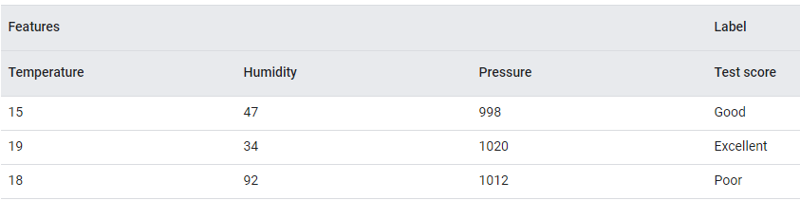
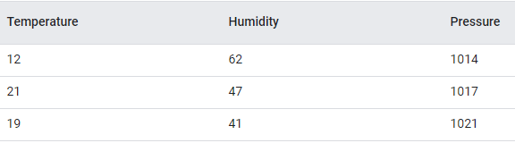
Supervised Learning
Training set (labeled examples)
Testing set (unlabeled examples)

Slide 4
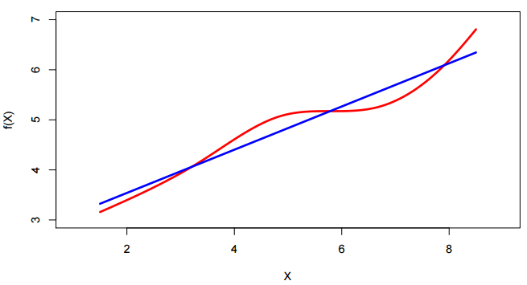
Linear Regression
Linear regression is a basic yet powerful method used in supervised learning. It assumes that the target variable Y depends linearly on the input variables X₁, X₂, ..., X_{p}. The assumption is
where ε is the error term accounting for deviations from the linear relationship.
True relationships in real-world data are rarely perfectly linear!
But linear regression often provides a reasonable approximation that is interpretable and useful.

Slide 5
Why Use Linear Regression?
Simple to implement and computationally efficient.
Easy to interpret — helps us understand which variables affect the outcome and how.
A great baseline model before moving to more complex methods.
Forms the foundation for many advanced models (e.g., logistic regression, generalized linear models).

Slide 6
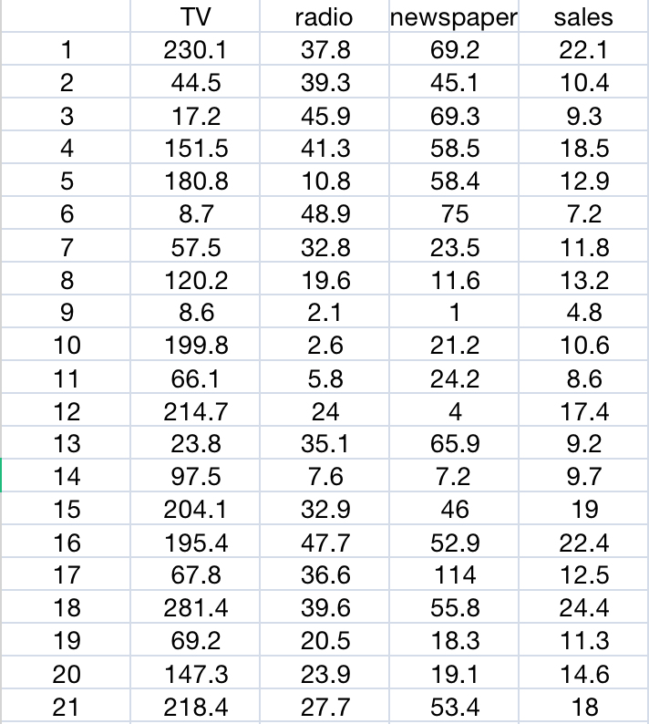
An Example
We’ll examine a dataset that tracks sales (in thousands of units) across 200 markets, vary with advertising budgets (in thousands of dollars) for: TV, Radio, Newspapers.
Questions we might ask:
  Is there a relationship between advertising budget and sales?
      Do increased ad budgets lead to higher sales?
  How strong is the relationship between advertising budget and sales?
      Can we measure how much of the change in sales is explained by changes in the ad budget?Which media contribute to sales?
  Can we use this data to predict future sales?
      If so, How accurately can we predict future sales?
  Is the relationship linear?
        Does a straight-line model make sense, or do we need something more flexible?

Slide 7
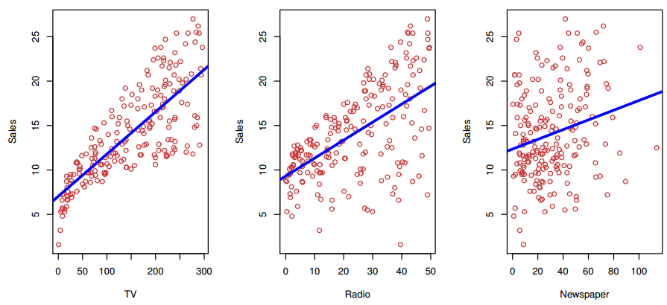
An Example on Advertising Data
In each plot we show the simple least squares fit of sales to that variable. In other words, each blue line represents a simple model that can be used to predict sales using TV, radio, and newspaper, respectively.
Notes:
The Advertising data set consists of the sales of that product in 200 different markets, along with advertising budgets for the product in each of those markets for three different media: TV, radio, and newspaper.

Slide 8
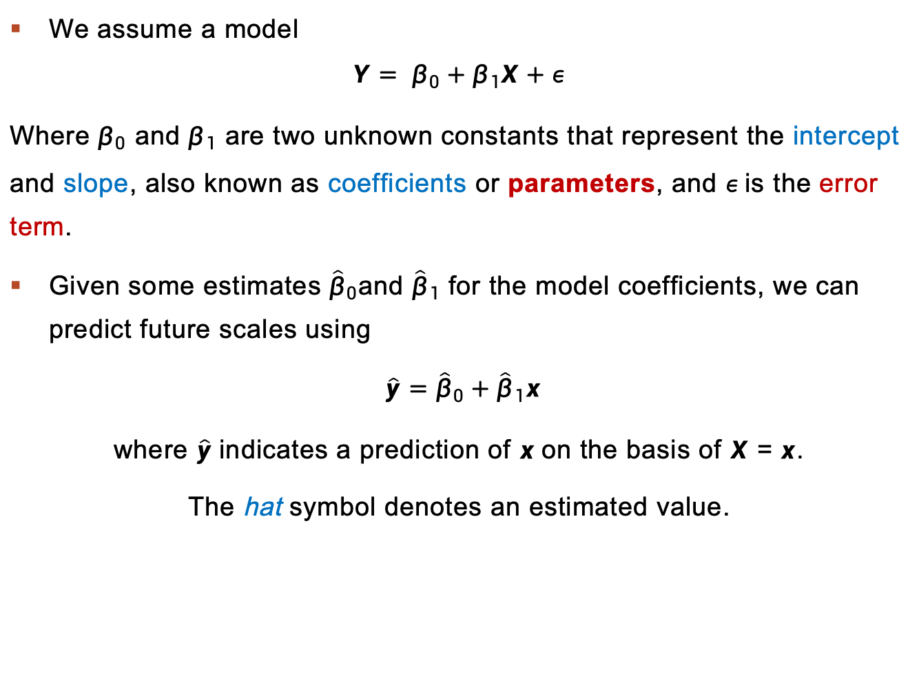
Simple Linear Regression
We assume a model
$$Y= β_{0}+β_{1}X+ε$$
Where $β_{0}$ and $β_{1}$ are two unknown constants that represent the intercept and slope, also known as coefficients or parameters, and $ε$is the error term.
Given some estimates ${\hat{β}}_{0}$and ${\hat{β}}_{1}$ for the model coefficients, we can predict future scales using
$\hat{y}={\hat{β}}_{0}+{\hat{β}}_{1}x$
where $\hat{y}$indicates a prediction of $x$on the basis of $X$ = $x$.
The hat symbol denotes an estimated value.

Slide 9
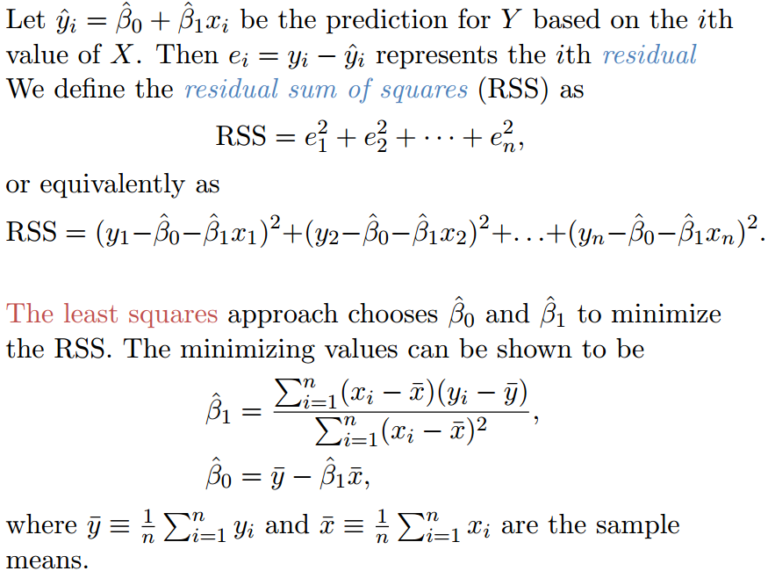

Loss Function
Least squares:

Slide 10
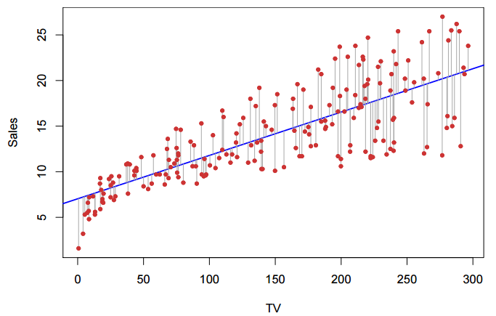
An Example
The least squares fit for the regression of sales onto TV. In this case a linear fit captures the essence of the relationship, although it is somewhat deficient in the following plot.

Slide 11
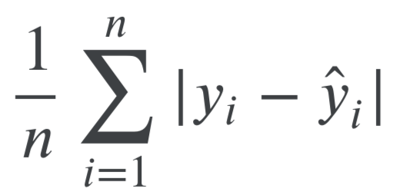
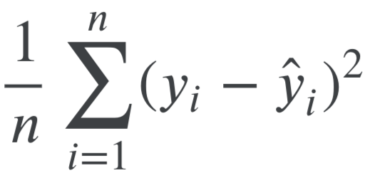
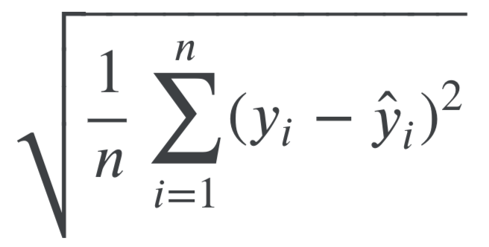
Evaluation Metrics
To assess the overall accuracy / performance of the model – MAE, MSE, RMSE, RSE, R²
  Mean Absolute Error (MAE)
    is the mean of the absolute value of the errors:
  Mean Squared Error (MSE)
    is the mean of the squared errors:
  Root Mean Squared Error (RMSE)
    is the square root of the mean of the squared errors:

Slide 12
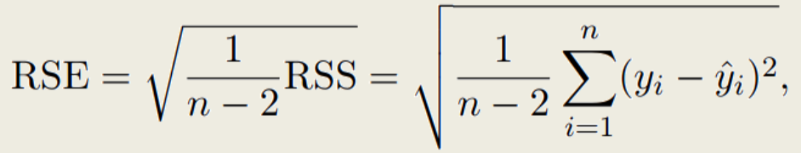

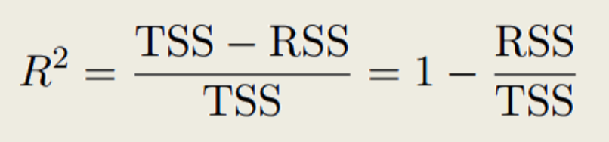

Measurements - Accuracy
To assess the overall accuracy / performance of the model – MAE, MSE, RMSE, RSE, R²
  Residual Standard Error (RSE) can be computed by
  where the residual sum-of-squares is
  R-squared(R²) can be calculated by
  where is the total sum of squares.

Slide 13
An Example
What’s the range of each metric?
  Higher/lower is better?
Evaluation Metrics | Value
RSE | 3.26
R² | 0.612

Slide 14
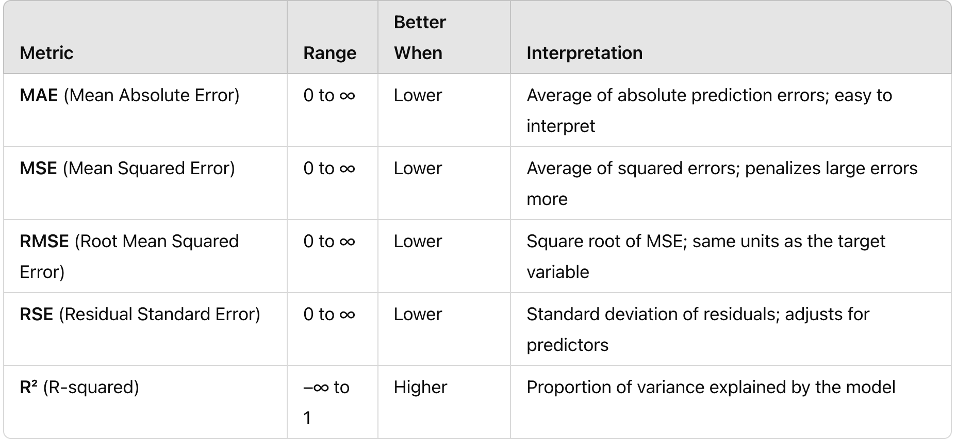
Evaluation Metrics Summary

Slide 15
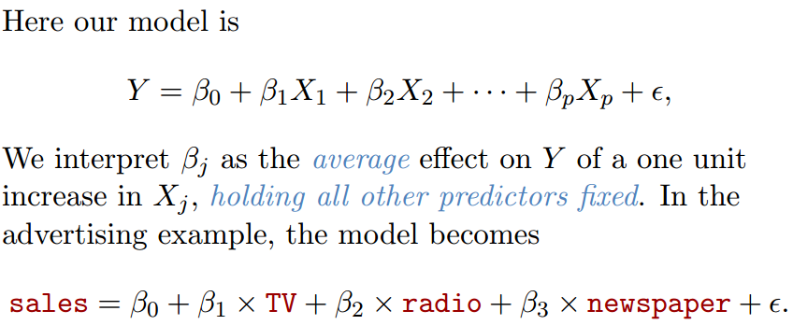
Multiple Linear Regression

Slide 16
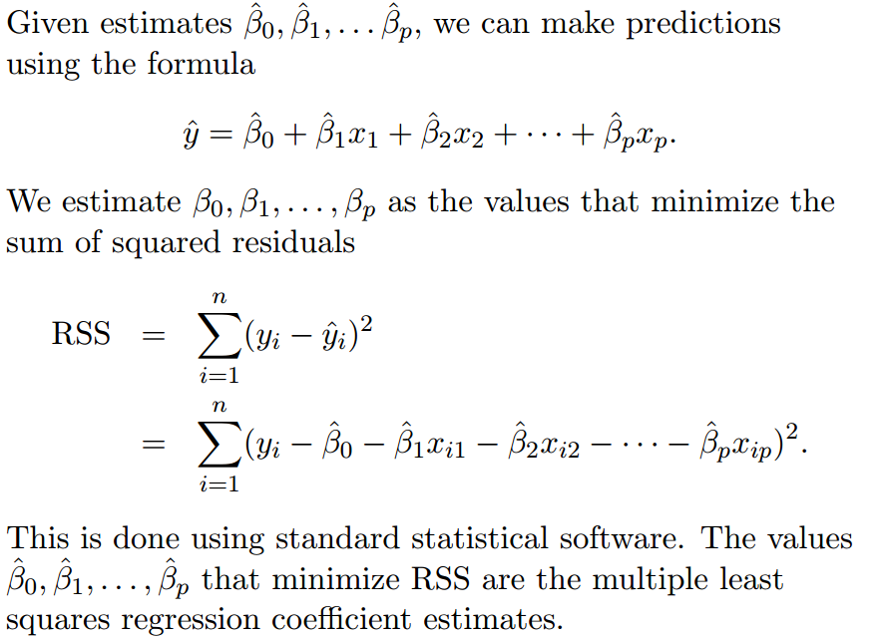
Estimation and Prediction for Multiple Regression

Slide 17
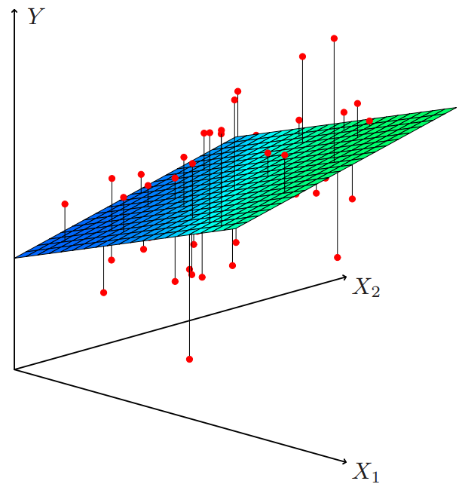
The Estimated Model
The estimated model for multiple regression in multi-dimensional space.

Slide 18
Some important questions
Is at least one of the features X₁, X₂, . . . , X_{p} useful in predicting the response?
Do all the features help to explain Y , or is only a subset of the predictors useful?
How well does the model fit the data?
Given a set of feature values, what response value should we predict, and how accurate is our prediction?

Slide 19
Important Variables
The most direct approach is called all subsets or best subsets regression: we compute the least squares fit for all possible subsets and then choose between them based on some criterion that balances training error with model size.
However we often can’t examine all possible models, since they are 2^{p} of them; for example when p = 40 there are over a billion models!
Instead, we need an automated approach that searches through a subset of them. We discuss two commonly use approaches next.

Slide 20
Python for Machine Learning
Fairly easy to read/write/process data using standard features
Frequently Used Packages
  Numerical and statistical manipulations – numpy¹
  Visualization (“plotting”) – matplotlib²
  Relational database like capabilities – pandas³
  Machine learning - scikit-learn⁴, tensorflow⁵, pytorch⁶, keras⁷
  https://datadependence.com/2016/05/scientific-python-numpy/
  https://datadependence.com/2016/04/scientific-python-matplotlib/
  https://datadependence.com/2016/05/scientific-python-pandas/
  https://scikit-learn.org/stable/tutorial/index.html
  https://www.tensorflow.org/tutorials/quickstart/beginner
  https://pytorch.org/tutorials/
  https://keras.io/api/

Slide 21
Summary
Simple Linear Regression
  Loss function
  An example
  Measurements: RSE, R²
Multiple Linear Regression

Slide 22
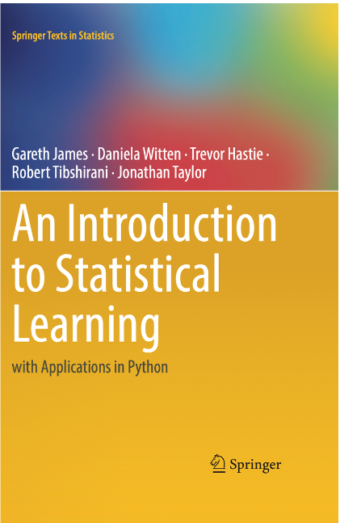
References
https://www.statlearning.com/resources-python
https://www.statlearning.com/
Gareth James, etl., ‘An Introduction to Statistical Learning: with Applications in Python’, Springer, 2023

